Slide 1
Light Bulb using C++ State Machine.
By Abhishek J S

Slide 2
What is State Machine?
A state machine is a behavior model. It consists of a finite number of states and is therefore also called finite-state machine(FSM). Based on the current state and a given input the machine performs state transitions and produces outputs.

Slide 3
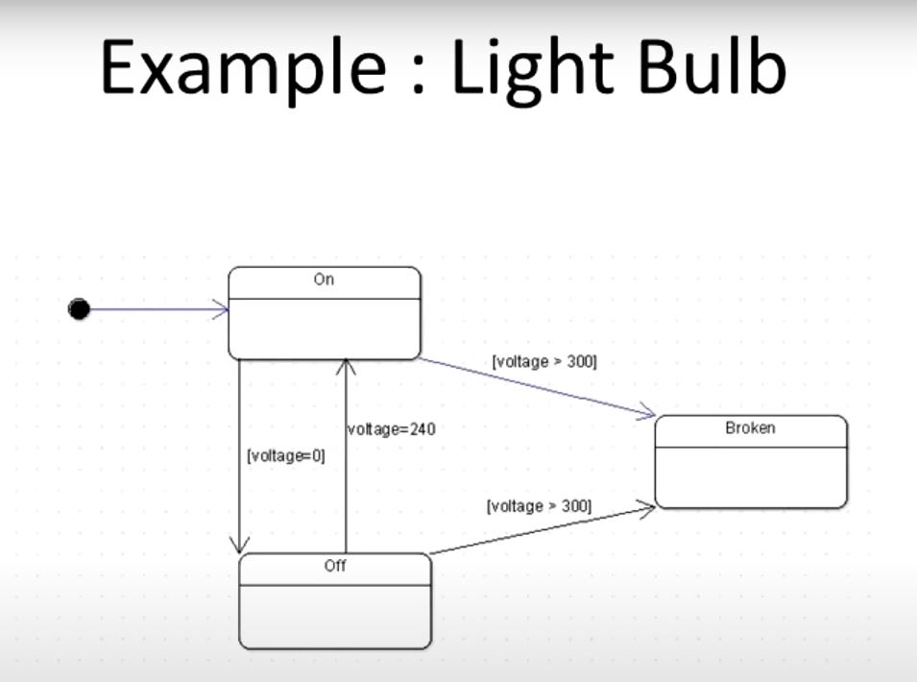
Example of Light Bulb using State Machine

Slide 4
Finite State Machine (FSM) for a simple system, that is a light bulb
Three states of light bulb.
Off- The bulb is off.
On- The bulb is on.
Broken- The bulb is broken.

Slide 5
Voltage is supplied to the bulb of the state transition.
If the voltage is 0V then the bulb is Off.
If the voltage is between 1V and 240V then the bulb is On.
If the voltage is more than 240V then the bulb is Broken.

Slide 6
Explain working of light bulb with state transition and state machine.
State
A state is represented by an enum named as StateEnum.
It showed as enum StateEnum {Off,On,Broken}.

Slide 7
Explain working of light bulb with state transition and state machine.
Transition
A Transition represents a change from one to another.
If the current state is On, the voltage is more than 240V, the bulb will transition to the Broken state.
If the current state is On, and the voltage drops to 0V, the bulb will transition to the Off state.

Slide 8
LinkedList for Transition
Use a container like template class.
Use to store transition for LinkedList.

Slide 9
Bulb Class
Simple abstraction of the bulb is Bulb class
It holds the current voltage and the FSM that controls the state of the bulb
FSM updated, whatever operator the voltage changes and the bulb’s state may transition state accordingly.

Slide 10
Bulb FSM
Step 1: Initialize the Bulb and FSM
When a Bulb object is created, the FSM is initialized with the Off state.
Bulb *bulb = new Bulb();
Four transitions :
From Off to On if the voltage is between 1V and 240V.
From On to Off if the voltage is 0V.
From On to Broken if the voltage if more than 240V.
From Broken to Off if the voltage is 0V.

Slide 11
Bulb FSM
Step 2 : Initial State – Voltage is 0V.
FSM starts in the Off state. When Update() is called, it checks the voltage and runs through the transitions. Since the voltage is 0V, the bulb remains in the Off state.

Slide 12
Bulb FSM
Step 3: Change Voltage to 240V.
Now, set the voltage to 240V and call Update() again. Since the voltage is between 1V and 240V, the FSM transitions the bulb to the On state.
Step 4 : Change voltage to 300V
Next, change the voltage to 300V and call Update(). The FSM transitions the bulb to the Broken state because the voltage exceeds 240V.
Step 5: Return Voltage to 0V.
Finally, set the voltage back to 0V and call Update(). The FSM transitions the bulb back to the Off state.

Slide 13
Thank you

